Slide 1
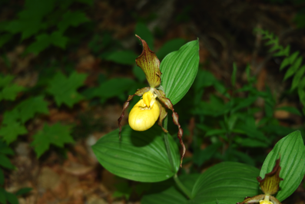
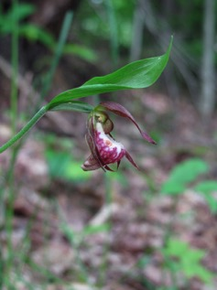
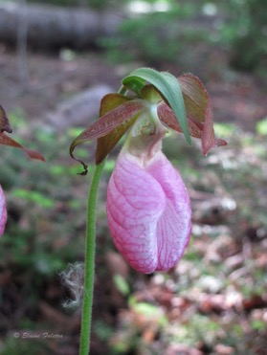
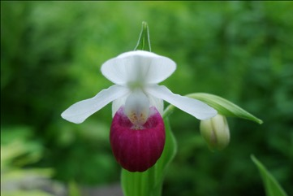
Saving the Beautiful Lady’s Slippers
Crossroads Academy Endangered Species Program
http://www.crossroadsacademy.org/
Notes:
K***
Good afternoon. Welcome to the Native Orchid Conference. We would like to thank the NHOS and Jean Stephanik for inviting us to present here today and partnering with us over the past 4 years.
Today our team from Crossroads Academy is going to present our program’s progress over the past 4 years at saving endangered lady’s sippers from extinction.
We will present what lady’s slippers of New England look like and their life style…; We will present to you how we are attempting to save these plants from extinction. We will show you how we grow the plants. We will also show you how you might also grow these spectacular orchids in your own gardens from seedlings we can provide to you.
We will have breaks for questions during the presentation. Please hold your questions until then.
Most people think of orchids as tropical plants and don’t know that some of the most beautiful orchids grow in New England. These amazing orchids are called slipper orchids and all belong to the genus Cypripedium from the Greek words “Shoe of Venus”.
Here we have pictures of the 4 different kinds of lady’s slipper orchids in New England. Three of these are on the verge of extinction in many parts of NE. Most people have seen the pink slipper…here at upper right.

Slide 2
The Pink Lady’s Slipper Cypripedium acaule
Notes:
K***
The pink slipper is the only slipper orchid that is not endangered because it is protected in NH since it is the NH state wild flower. I’m not sure what protected means other than your not supposed to pick it.
Can anyone tell me what the state flower is?
Now Daniel will talk about the showy lady slipper

Slide 3
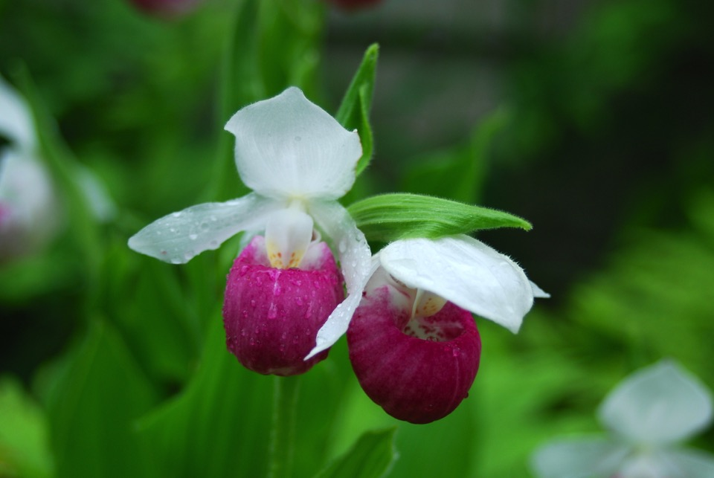
Notes:
Dan
The showy lady’s slipper is a beautiful flower and a flagship of endangered flowers of the world.
We are really lucky to have it here in New England.
In NH, there are less than 5 locations where this plant is thriving in the wild. This is why it is considered critically endangered.
Our plan is to use garden clubs and conservation organizations to create sanctuaries for the slippers, with us providing the plants to them free.
If this approach works, we would like to advance it as a model for rescuing endangered plants in the world.
The showy slipper often has two stunning flowers on each plant.

Slide 4
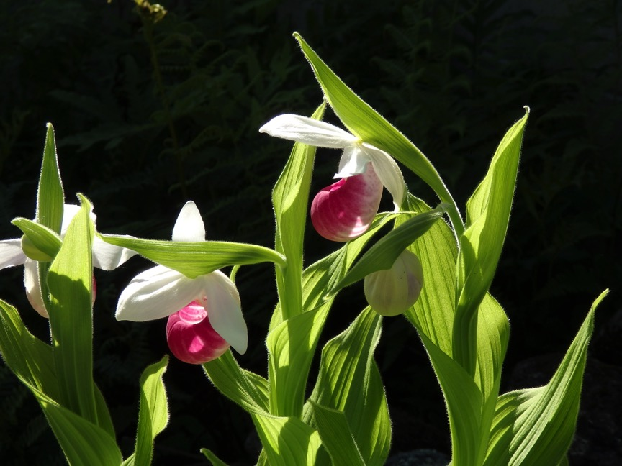
The Showy Lady’s Slipper Cypripedium reginae
Notes:
Dan
The showy Lady’s slipper shown here is critically endangered because of habitat loss and habitat degradation and to a lesser extent illegal collection.
We want to prevent this plant from extinction in New England and are studying everything about it from how to grow it artificially in our lab’s tissue culture system, to how it grows in its natural habitat.

Slide 5
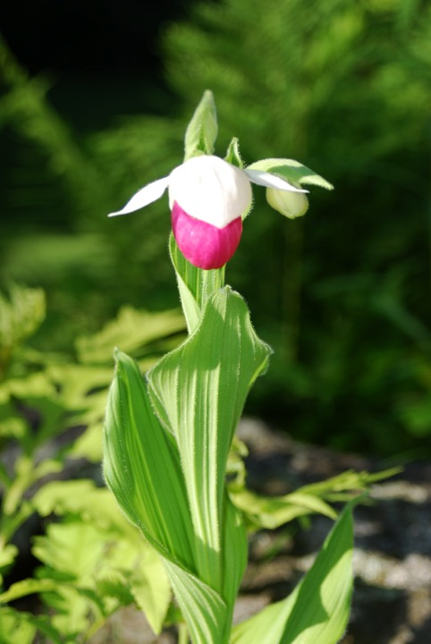
Notes:
Dan
Often the two flowers emerge at different times. Here one blossom is just opening in mid June to reveal its fuchsia pouch...the other in the rear is not open.

Slide 6
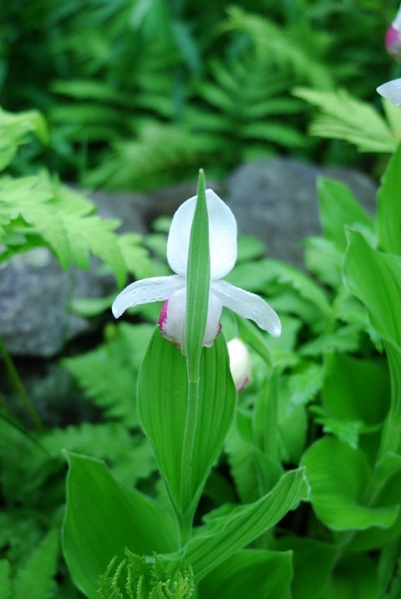
Notes:
Dan
Here is the rear view of the showy flower…the two vertical white sepals and the side white petals.
It has large leaves alternating up its stem.

Slide 7
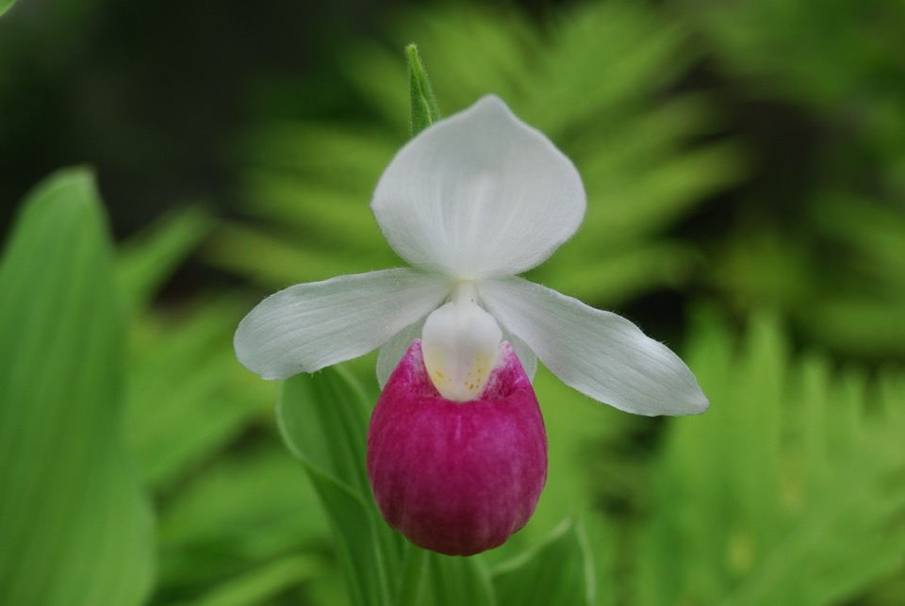
Notes:
Dan
the showy slipper has a bold fuchsia pouch. The fuchsia pouch is actually a petal evolved to trap insects and help pollination. This vertical large sepal is two sepals that are fused. The yellow spotted structure is the staminode that hides the male anthers and the female stigma to the rear.

Slide 8
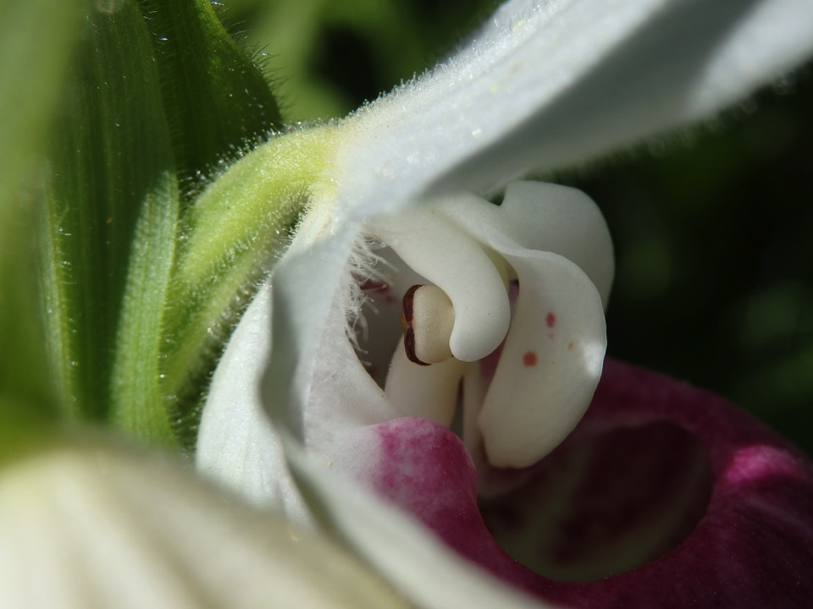
Ovary
Pollen
Stigma
Staminode
Pouch
Notes:
Dan
From the left we have the ovary,
then the anther that has a mass of brown sticky pollen,
then the female structure called the stigma,
and the staminode in the front. Notice that the leaves, petals, sepals, and
pouch have numerous hairs. Katherine will explain what these and other parts of the slippers
look like under the microscope later, but now I am going to turn over the speaking to Claire to describe the yellow slippers.

Slide 9
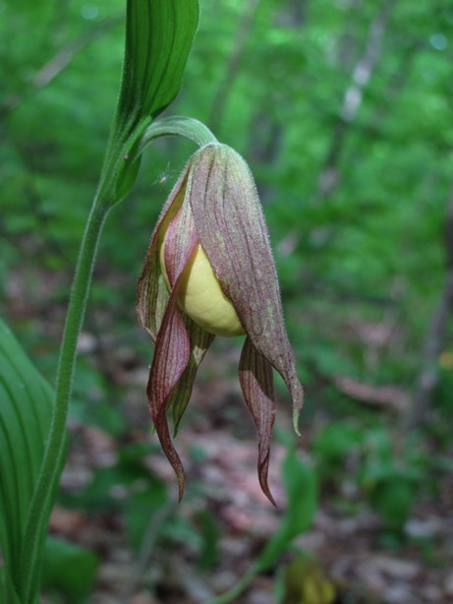
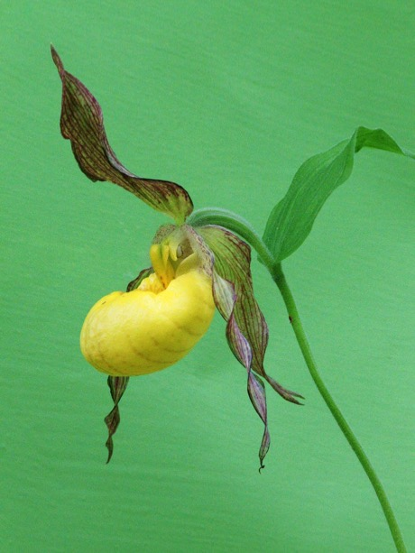
The Yellow Lady’s Slipper Cypripedium parviflorum
Notes:
Claire
Plants are categorized on their flower structures, so the yellow slipper has the same basic structure as the showy slipper but the sepals and petals are different colors and slightly different shapes. Again we can see the fused upper sepal and the third sepal behind the yellow pouch that is again a modified petal. As the flower opens, the interior petals are more exposed. In the yellow slippers, the sepals as well as the side petals, are twisted or curled. In some of the tropical cousins, these sepals are over a foot long. Yellow slippers are also covered with hairs that can irritate skin. American Indians supposedly used to eat the yellow slipper roots to kill worm infections…we haven't tried this since none of us has worms

Slide 10
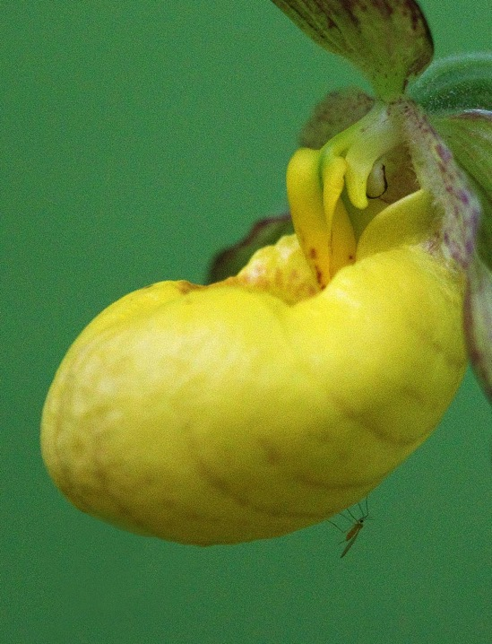
Staminode
Pollen mass
Stigma
Mosquito
Notes:
Claire
The yellow slipper has the same reproductive structures as the other slippers.
Staminode that shields the reproductive structures.
Pollen mass on the anthers.
and again, the stigma sits between the staminode and the anthers.
They don’t always come with mosquitoes.

Slide 11
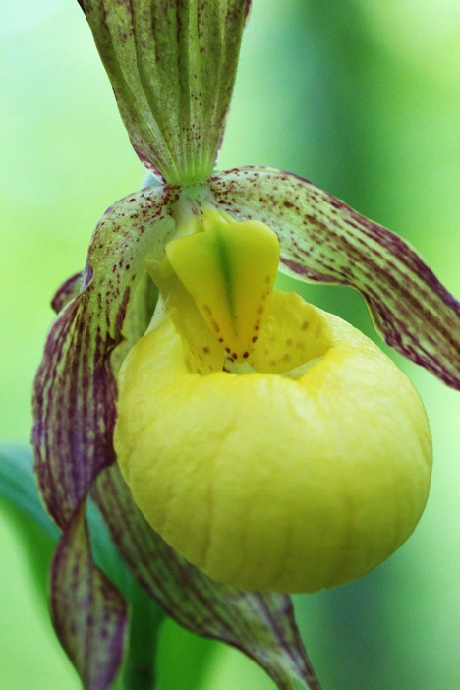
Notes:
Claire
the staminode on the yellow slipper has red spots, like the showy.

Slide 12
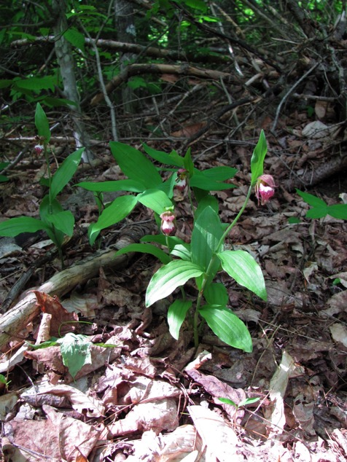
Ram’s Head Lady’s Slipper Cypripedium arietinum
Notes:
Claire
Of all the slippers, the smallest is the ram’s head… the entire plant is about 12 inches tall.

Slide 13
Notes:
Claire
The flower is the size of a US quarter and does resemble a ram’s head.

Slide 14
Pollen mass
Stigma
Staminode
Notes:
Claire
It has the same reproductive structure as the other lady’s slippers.
Pollen mass on the anthers.
Stigma and
Staminode

Slide 15
The Pink Lady’s Slipper Cypripedium acaule
Pollen
Staminode
Stigma
Notes:
Claire
The pink slipper also has the same floral structure as all slippers --
staminode and
a portion of the stigma and
pollen to the rear of the staminode,

Slide 16
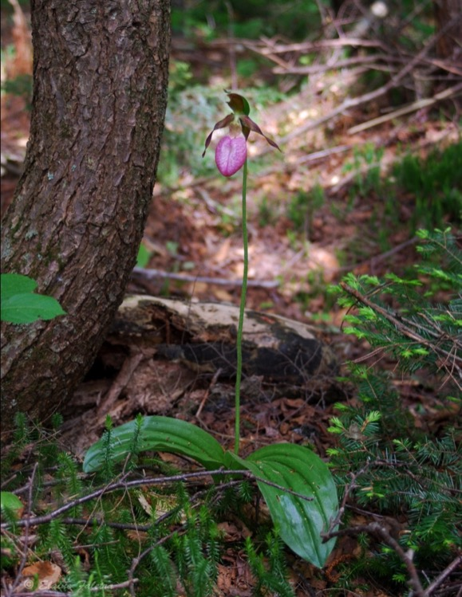
Notes:
Claire
Unlike its cousins in the Cypripedium genus, the pink slipper has no stem…just a lonely peduncle, this is why it is sometimes called the stem-less lady’s slipper.
Now that we know what the flowers and plants look like, I will turn it over to Katherine and Aidan to describe what these plants look like under the microscope.

Slide 17
From the Outside Looking
Exploring the Tissues of the Cypripedium Species
Notes:
K***
If we are to understand how lady’s slipper grow and reproduce, we must look at the tissues under the microscope.
We have begun a thorough analysis of all the slipper tissues, especially the reproductive and multiplying or meristematic tissues.
We would like to clone a showy slipper…which has never been done.

Slide 18
Notes:
K***
All 4 species of our lady’s slippers have numerous hairs. This is what a hair looks like under the microscope. There is a chemical at the end of the hair that is released when you touch it and can cause skin irritation. The hair shows three distinct regions: the head, with what appears to be a dense staining nucleus, a thin mid-section again with a possible nucleus, and a wide base section. There is a fourth section shown in the next slide that attaches the hair to the epidermal tissue.

Slide 19
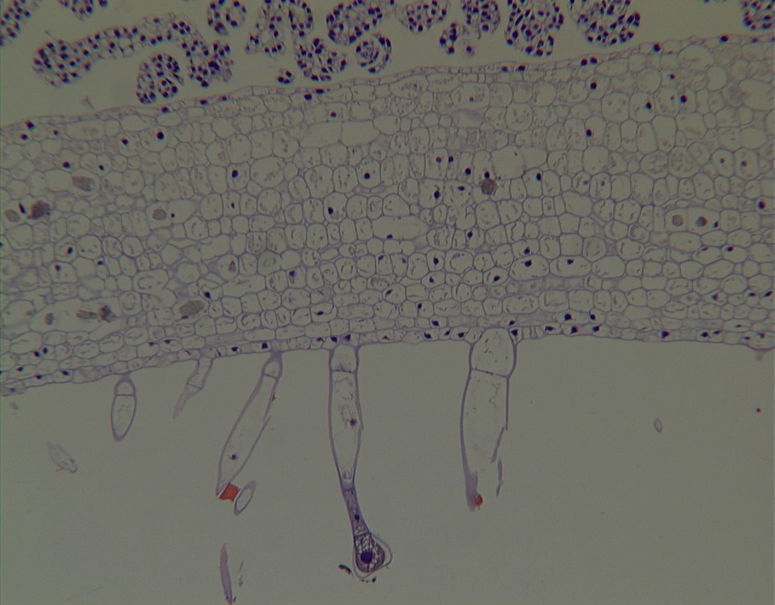
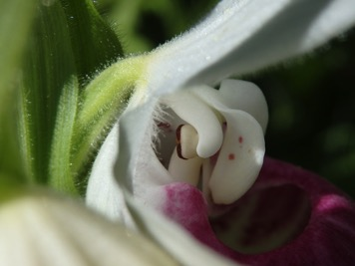
Notes:
K***
This is a longitudinal section of the ovary (point to the ovary in the lower right) in the spring of a mature flower of showy slipper. This means we cut through it lengthwise.
From the bottom up, you can see some hairs and the base section I mentioned in the previous slide. The seed capsule which like in many orchids is pretty tough, has about 16 layers of dense cuboidal cells. At the top of the field are the ovaries.

Slide 20
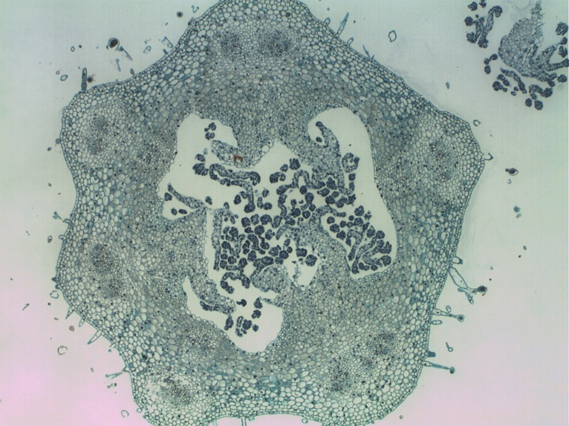
Notes:
K***
This is a cross section of a yellow slipper ovary collected in May, where instead of cutting lengthwise, we cut across the width of the ovary. It appears the same as the other 3 local species. It has hairs. The ridges show here as bulges. (point) Just inside of each ridge are conductive cells to carry nutrients to the seed pod as its ovules develop. (point)
Here is Aidan to explain an interesting point from this section.

Slide 21
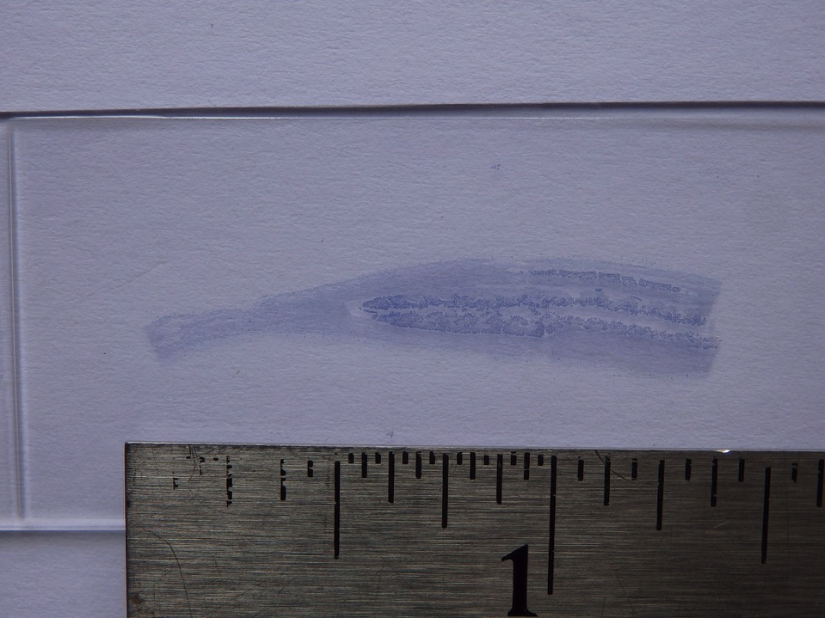
Notes:
Aidan
As Katherine showed you in a close-up in the microscope there are many ovules in each ovary. If we zoom out to actual size and look inside a single ovary of a mature yellow slipper flower in spring, we can see in this image many ovules ready to be fertilized. each one of the thousands of ovules must have a pollen deliver its nuclei. If enough ovules in a ovary are not fertilized the seed pod will wither and die. This is common in plants and is still a mystery as to how the plant knows what is enough to keep investing energy in the developing seeds.

Slide 22
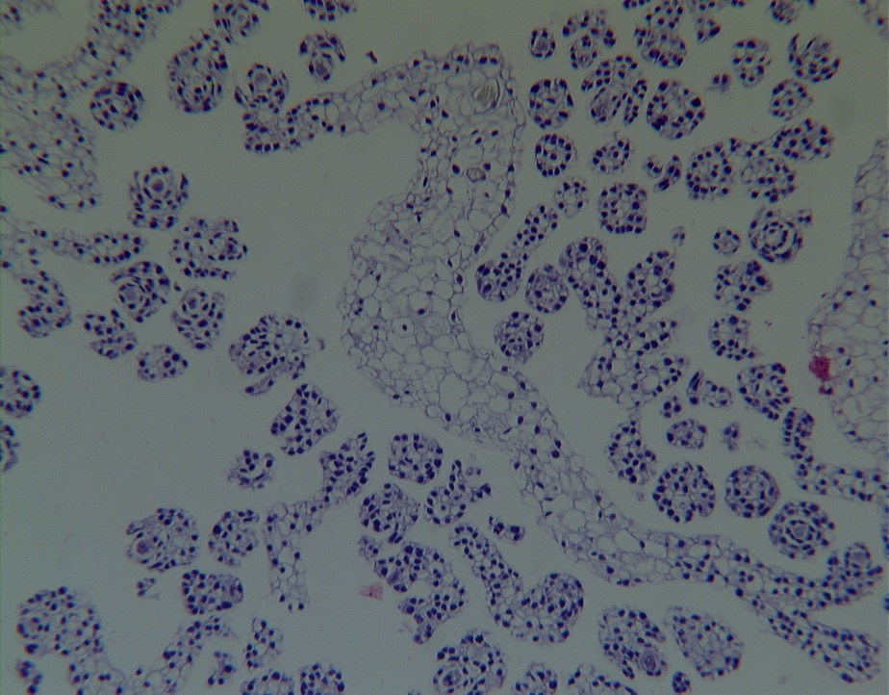
Notes:
Aidan
As Katherine also mentioned, these are the ovules. (point)
Each of these circular arrangements of nucleated cells is a developing ovule that, if fertilized by a pollen, will each develop into a seed. In all flowering plants the pollen has two nuclei…one fertilized two central nuclei in the ovule and the other fertilizes the egg cell. The fertilized egg cell will become the embryo that will develop into a plant…the other nuclei that have fused to form the nutrient tissue. In apples , watermelons, corn, grass and every flowering plant’s seed, this is the bulk of the seed. In orchids this tissue never develops. Orchids have no nutrients to grow and as you know they are supplied by a commensal fungus.

Slide 23
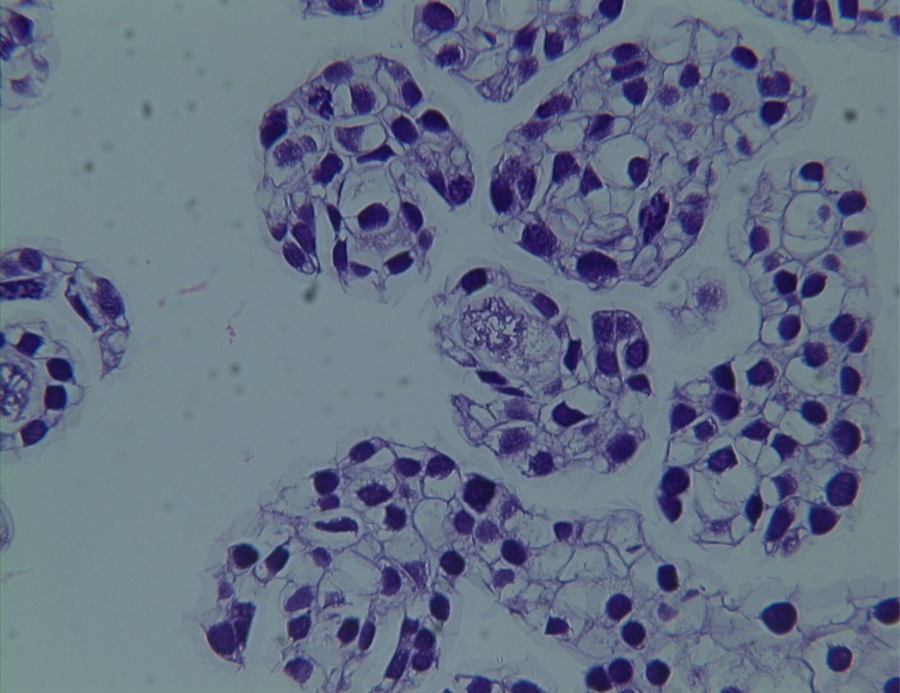
Notes:
Aidan
Here is a closeup of a ovule that happens to reveal it chromosomes
Point out chromosomes…
.

Slide 24
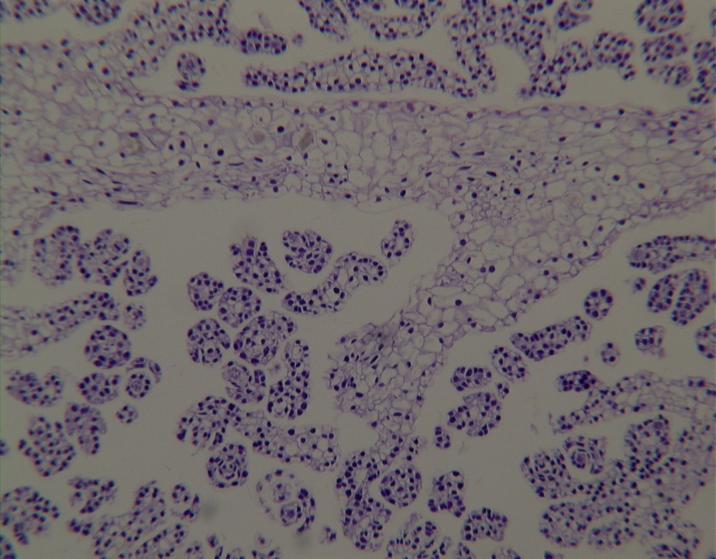
Notes:
Aidan
One of our goals in our research is to find out whether common beliefs about slippers are true. One is that a yellow or showy slipper seed pod has many thousands of seeds. Some sources say as few as 10 0r 20,000, others say as many as a million. How do we verify how many. We took an average sized seed pod of Cyp. parviflorum. We counted the ovules in a single section of the seed pod. There were about 70.

Slide 25
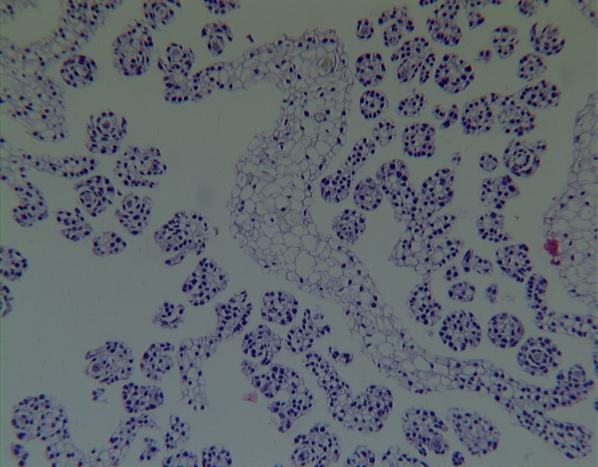
We counted ~70 ovules in one section. Since an ovule is about 10 microns thick and
each section is 3 microns thick one ovule would be in three successive sections. Since a single ovary is 3 cm long there are about 10,000 slices in each ovary.
Therefore one ovary has about (70 x 10,000) ÷ 3 = 210,000 potential seeds.
Notes:
Aidan
Let’s do some math.
If we assume that a slice is about three microns thick and a small seedpod is 3 cm thick, we know that there are around 10,000 slices or slides in a seedpod. we have counted about 70 ovules in one slide. Since the ovules are about 10 microns thick (remember that the slides are 3 microns thick) one ovule will show up in about three slides. Therefore a conservative estimate of the total number of ovules in one seed pod is around 10,000 / 3 x 70, which, if we round 10,000 / 3 to 3,000, is around 210,000

Slide 26
Notes:
Aidan
This is the stigma surface of the showy slipper. The large cells on the right are likely some type of receptor cell for the pollen.

Slide 27
Notes:
Aidan
Here we have a section through the reproductive structures of the ram’s head slipper. On the far right is the lower part of the stigma, the middle shows a few hundred pollen grains and to the far left is likely a remnant of the pollinea/anther from which the pollen has been torn away during preparation of the sample.

Slide 28
Notes:
Aidan
The pollinea of ram’s head with pollen grains in the center…the outer lacy structure we suspect is the sticky substance that holds the pollen mass together.

Slide 29
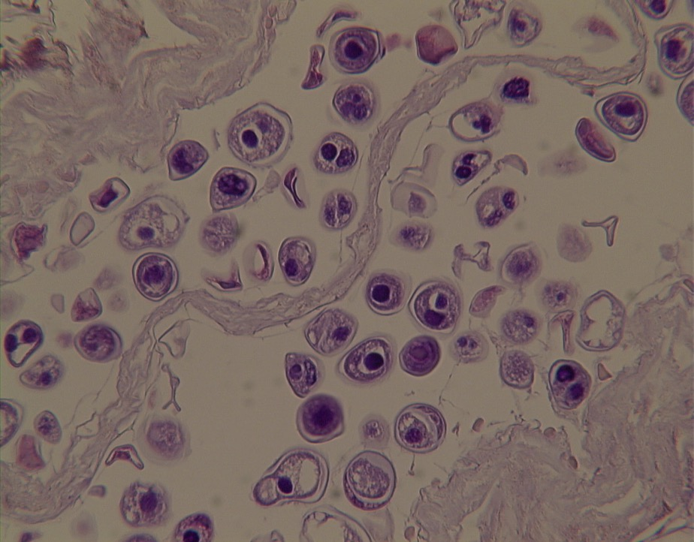
Notes:
Aidan
Zooming in on the pollen of ram’s head. Although it doesn't’t always show up, each pollen grain has two nuclei….point.
Katherine…

Slide 30
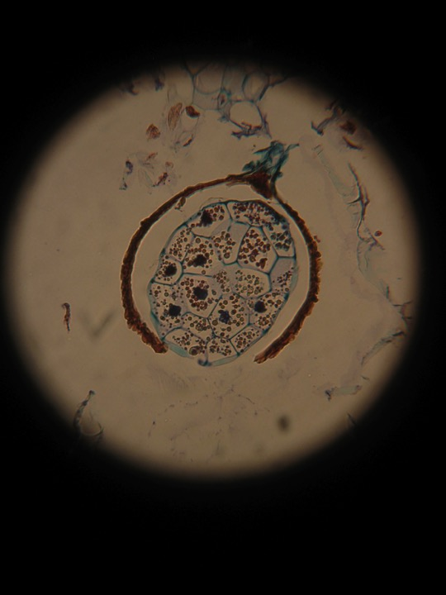
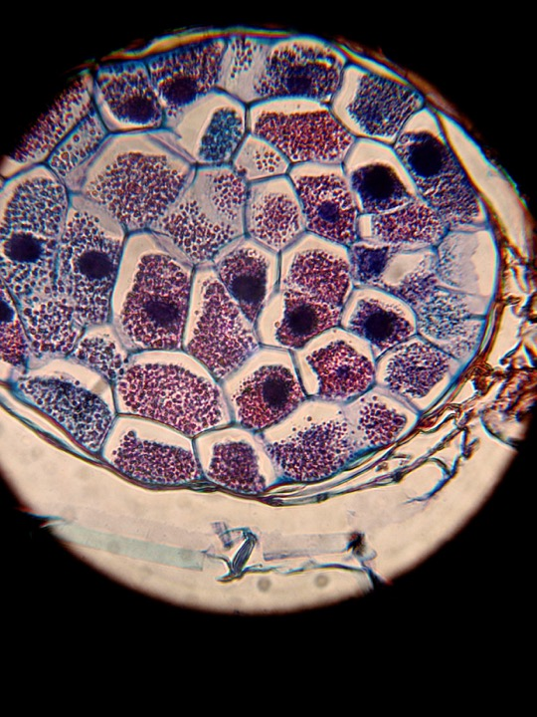
Notes:
K***
Before taking some questions, I wanted to point out the difference in the microscope of the embryos of the mature seeds of ram’s head on the left and the yellow slipper on the right. These were both take under the same magnification. The ram’s head is a much smaller seed with a much thicker seed coat and also has far fewer cells and plastids in its cells.

Slide 31
Questions ?
Notes:
K***
Do you have any questions on the tissue work for us so far?
I will turn it back to Claire.

Slide 32
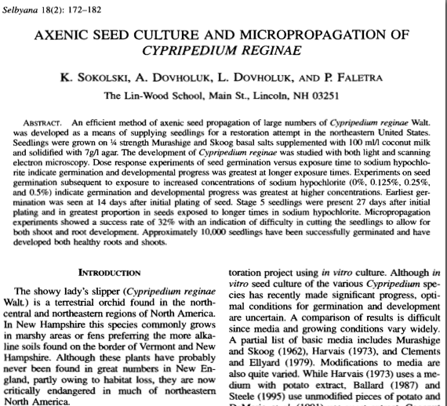
How did this all start?
Notes:
Claire
Now for a quick history lesson. It actually began with Charles Darwin the famous biologist “not in the upper left”. When he wasn't busy discovering how evolution worked and writing books, he tried growing lady’s slippers. He never succeeded, and for the next century and half or so lady’s slippers were very difficult to grow from seed usually taking about 9 months to germinate.
About 20 years ago, Dr Faletra's former students, figured how to get the seeds to geminate in a few weeks.
This is their publication and it provided a method for drastically increased germination and developmental rates of the showy slipper.
It was published in 1998, and from what the people at the Smithsonian Institute told us, it changed the landscape of how people grew temperate Cypripedium species in the world.
Now I will hand off the presentation to Emma. She will talk about the conservation program at Crossroads Academy and the seed of lady’s slippers

Slide 33
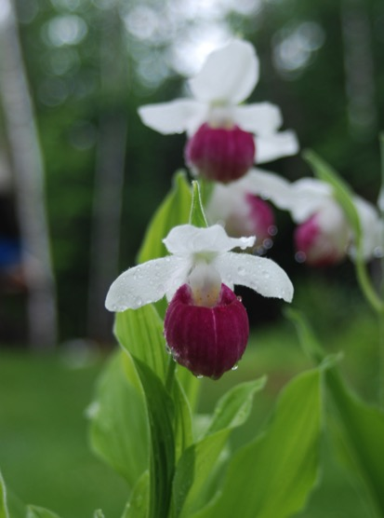
The Program at Crossroads
Study how to grow them in sterile culture
How to transplant them to soil
how to get them to survive in the wild
create sanctuaries around the state
Notes:
Emma
At the Crossroads Academy, we have continued this research.
What we are trying to do, as Katherine mentioned in the first slide, is to prevent this plant from extinction in NH.
We are doing this by raising thousands of these plants in our seed culture system.
We use the plants to study and to create sanctuaries where the plant will have a safe home for a long time..
We have a sanctuary on our campus. We have created 8 other sanctuaries on private lands where the owners have committed to protecting the location.
We will also create a small number of sanctuaries in other parts of the states of NH and VT that will be natural habitats with enduring stewardship.
We are always looking for partners in this effort, especially garden clubs and organizations like the NHOS.

Slide 34
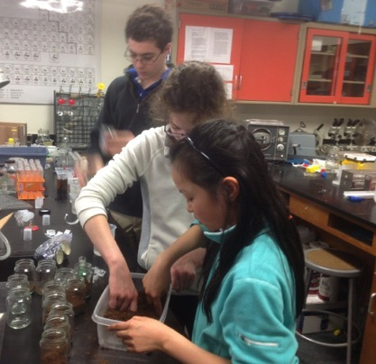
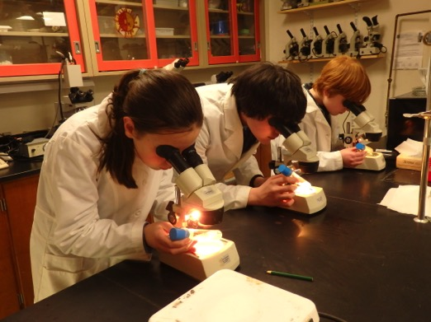
Our Lab
Notes:
Emma
The students at Crossroads Academy perform extensive research on the laboratory growth, development, and natural requirements of the slippers
The plan is to learn how to efficiently grow thousands in culture and study how to have the best survival when transplanted to their wild habitats.

Slide 35
What are we culturing?
We are culturing
4 slippers:
Cyp. reginae
Cyp. parviflorum
Cyp. arietinum
Cyp. acaule
Notes:
Emma
We are growing all 4 slippers of New England:
Cyp. reginae… the showy lady’s slipper

Slide 36
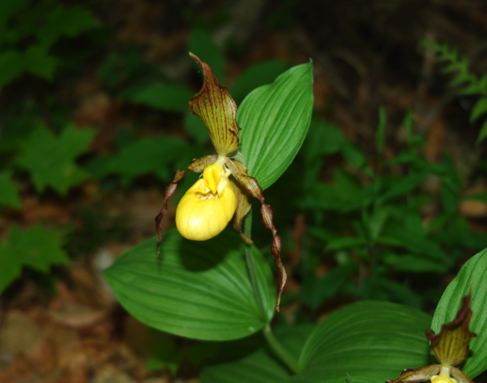
What are we culturing?
We are culturing
4 slippers:
Cyp. reginae
Cyp. parviflorum
Cyp. arietinum
Cyp. acaule
Notes:
Emma
C. parviflorum… the yellow

Slide 37
What are we culturing?
We are culturing
4 slippers:
Cyp. reginae
Cyp. parviflorum
Cyp. arietinum
Cyp. acaule
Notes:
Emma
C. arietinum… the meek but powerful ram’s head… and

Slide 38
What are we culturing?
We are culturing
4 slippers:
Cyp. reginae
Cyp. parviflorum
Cyp. arietinum
Cyp. acaule
Notes:
Emma
C. acaule… the most common of all pink slipper

Slide 39
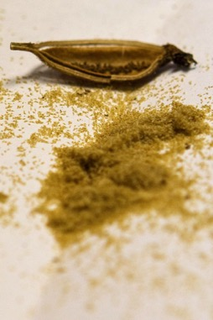
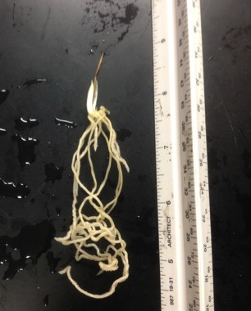
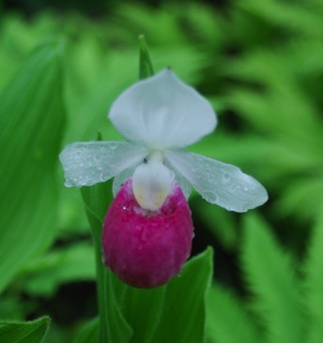
How?
Seed
Flowering Plant
Plant in Soil
Seedling
Vernalization
Notes:
Emma
We believe that we need to understand how to best germinate seed to produce seedlings efficiently. We must know how to vernalize seedlings, which is to mimic their dormancy in the winter, how to get the best survival when transplanting to soil, and finally, how to make sure seedlings mature to a flowering state in the wild or in sanctuaries.
Now Fiona will talk about the seeds!

Slide 40
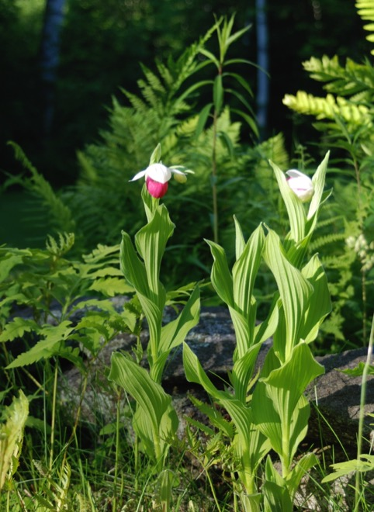
Seed
Notes:
Fiona
Although a single showy slipper seed pod can produce one-quarter of a million seeds, less than 1% of those will ever germinate, and less than 1% of those will grow to produce flowers.
It takes about 8-10 years to get to this flowering stage in the wild.
Our system reduces this time in half...and with much better survival rate of greater that 50%
How do we do this?

Slide 41
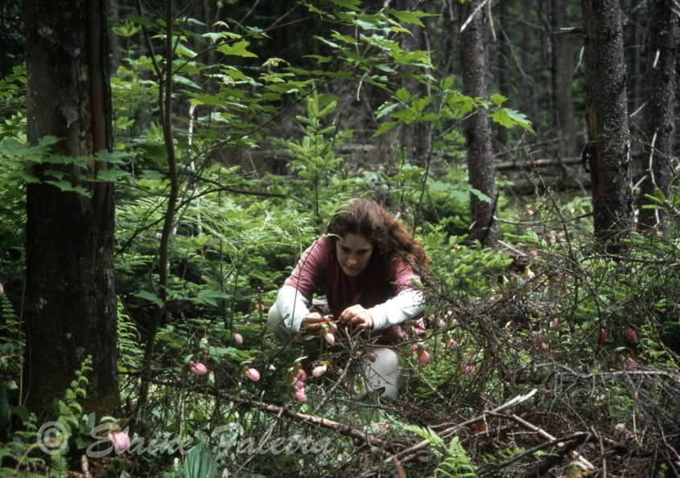
Cross-Pollination
Notes:
Fiona
In the spring we imitate bees and cross-pollinate slippers with toothpicks to help ensure a sufficient supply of seeds to germinate in our lab. We have found that less than 15% of the flowers produce seed pods each year. This isn’t surprising when you think of what has to happen…For each seed in the pod, there had to be an egg cell, and each egg cell had to be fertilized by a pollen cell. this has to happen thousands of times for a single seed pod.

Slide 42
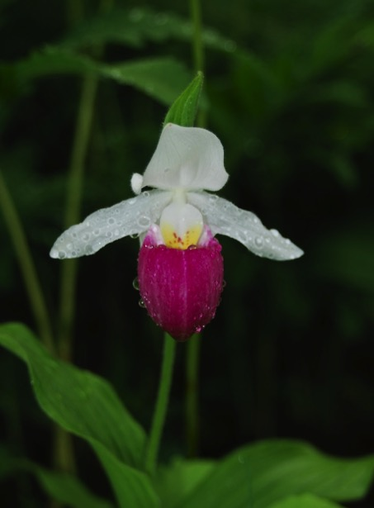
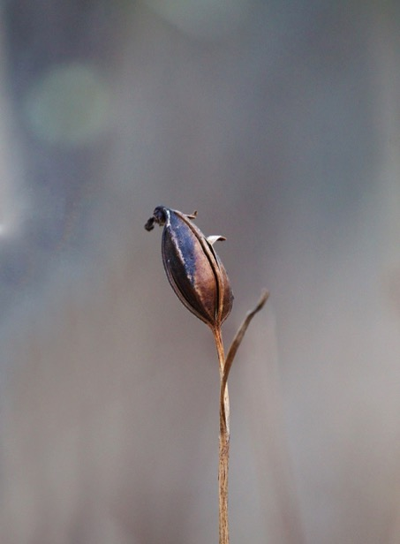
First we need the seeds
Notes:
Fiona
The flower that was pollinated in the spring has produced a fruit or seed pod in the fall.
This is a pod in October after it has DEE-HISSED or split open and released its seeds. We want to collect seed pods in mid-September, just as the pods are about to turn brown and before they split open so we can get the seeds before they are blown away in the wind.

Slide 43
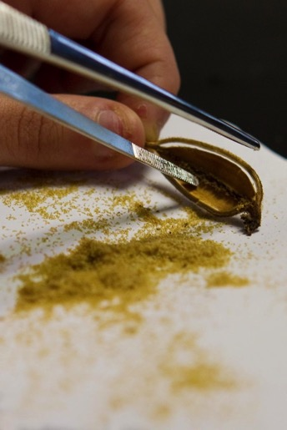
Harvesting the Precious Seeds . . .
Notes:
Fiona
We collect pods only from NH. We get them from the plants at Dr. Faletra’s home. We take the seed pods back to our lab. We allow the pods to dry out for a week or so and then scrape the seed out. They are tiny...less than a 16th of an inch long. Orchid seeds are peculiar in the plant world. They are tiny because they have no built in food supply like a corn seed or apple seed. orchid seeds rely on a fungus to supply them with food and to germinate in the wild.
Dan will now bring you up closer to the seeds.

Slide 44
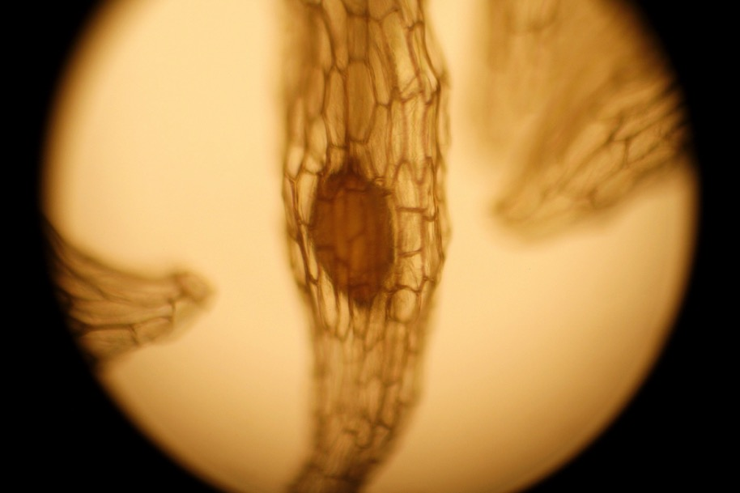
Slipper Seeds
Notes:
Dan
Here is a close up of a showy slipper seed.
You can see the outer seed coat made up of a number of flat columnar cells that surround an embryo (POINT TO THE EMBRYO).

Slide 45
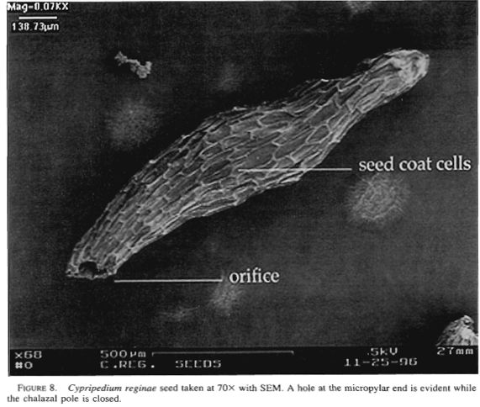
The Seed of C. reginae
Notes:
Dan
Here is a Scanning Electron microscope image of a showy slipper seed.
It shows the seed is about a millimeter long. Again you can see the numerous cells that make up the seed coat. This end of the seed (POINT) is like the umbilical cord of the seed. It is the part that is attached to the seed pod’s inner wall

Slide 46
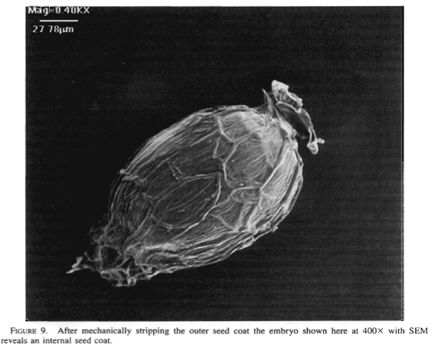
We Stripped Off the Outer Seed Coat
Notes:
Dan
One of the students used a scalpel and a fine tweezers and stripped away the outer seed coat to reveal yet another inner seed coat around the embryo. In the wild, a fungus will eat this coating and then help the embryo germinate. We use tricks in the lab to dissolve the coat and feed the embryo so it grows quickly to a seedling.

Slide 47
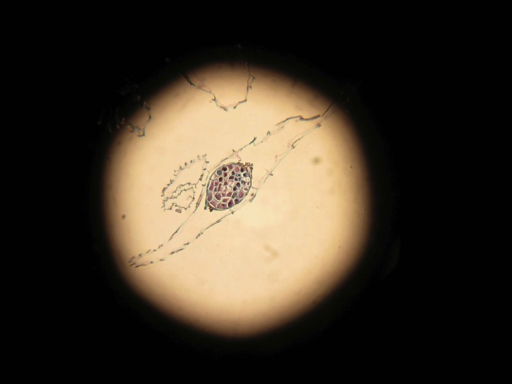
A seed sliced and stained
Notes:
Dan
We took some of the seeds to a local hospital pathology lab where they stained seeds with the pap-smear stain.
Then they made a thin slice of the seed and stained it revealing the embryo in the seed coat shown here.
If we zoom in on this image we see…

Slide 48
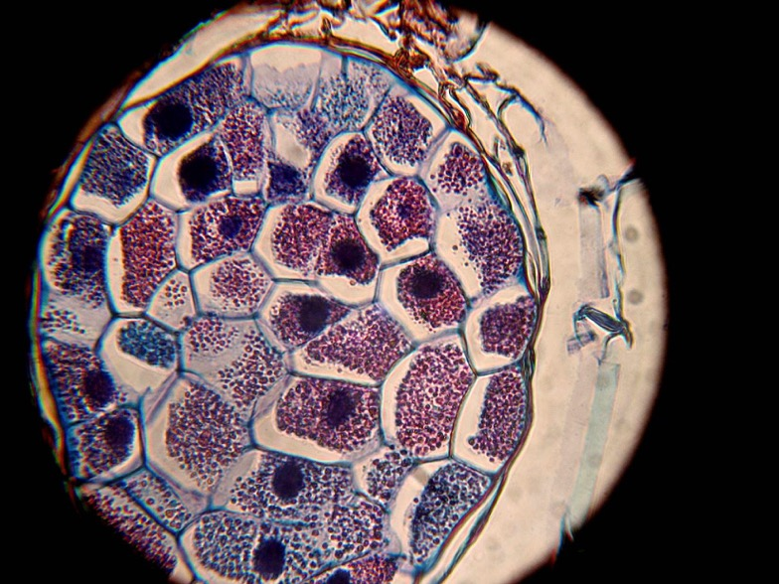
Notes:
Dan
… a close-up and find this slice of the embryo is made of about 25 cells in this slice.
****
Now let’s take a small break for questions. Any questions? [NO MORE THAN 3]
****
Now Irina is going to explain our process of growing the seeds in test tubes

Slide 49
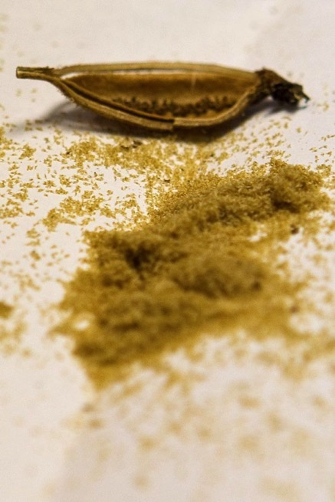
We use the seeds to grow seedlings in sterile culture
Notes:
Irina
We use the seeds to grow seedlings in a special gelatin medium called agar. We supplement the agar with all the nutrients the seeds need to germinate and grow.

Slide 50
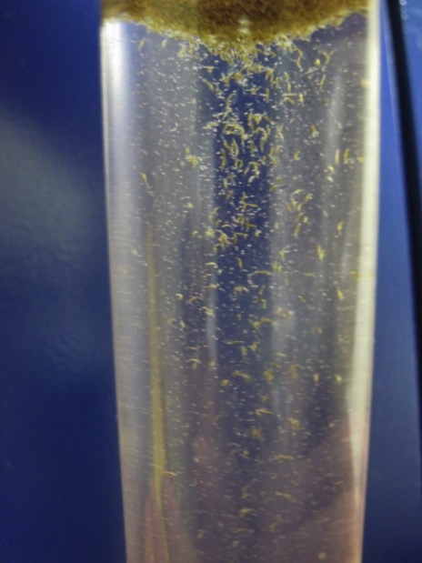
Weakening the seed coat
Notes:
Irina
Here we are mixing a few thousand seeds in a test tube filled with a solution of bleach.
This surface sterilizes the seeds and reduces our chances of growing mold and bacteria which would overtake the cultures and kill the seedlings.

Slide 51
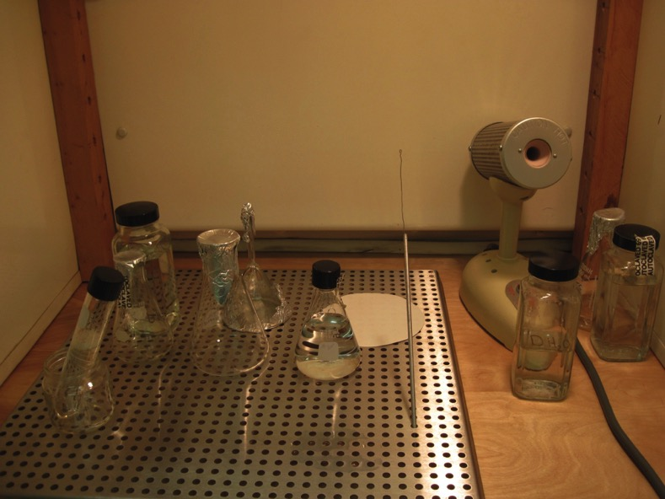
Inoculating the Seeds
Notes:
Irina
This is the equipment we use to put the seeds into sterile agar

Slide 52
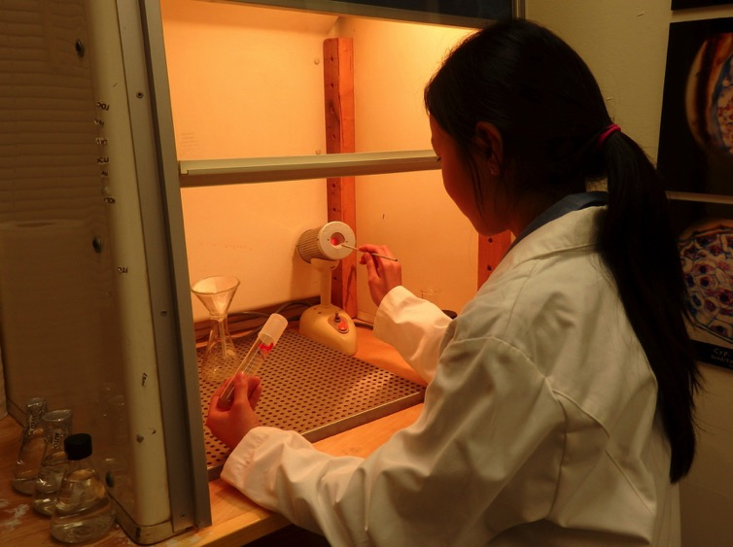
Inoculating the Seeds
Notes:
Irina
First we sterilize a wired loop.

Slide 53
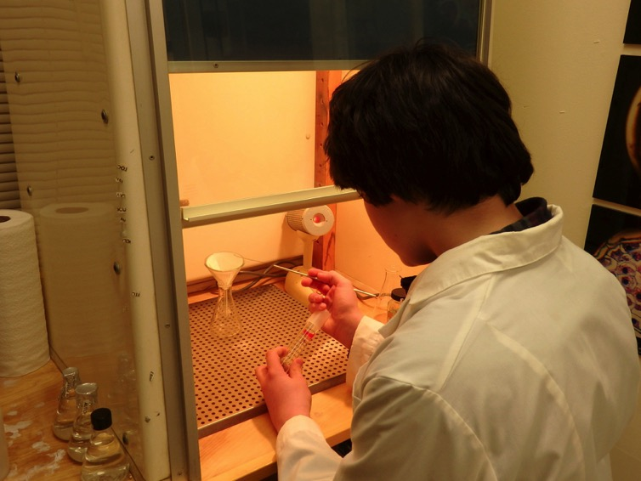
Inoculating the Seeds
Notes:
Irina
Then we pick up some sterile seeds that we caught in a paper funnel.

Slide 54
Inoculating the Seeds
Notes:
Irina
We carefully open the test tube.

Slide 55
Inoculating the Seeds
Notes:
Irina
We insert some seeds into the agar at the bottom of the tube.

Slide 56
Sealing the Tubes
Notes:
Irina
We seal our tubes with a plastic film to prevent unwanted mold and bacteria from sneaking into the cultures.

Slide 57
Notes:
Irina
No matter how careful we are, sometimes, mold finds its way in anyway…here we have successfully grown at least 3 kinds of mold!!

Slide 58
Notes:
Irina
All the tubes are carefully labeled…you can again see some of our amazing growth of mold ☺

Slide 59
Stage 1
Stage 2
Stage 3
Stage 4
Notes:
Irina
Within 1 week of placing seeds in culture tubes, we count how many seeds are in each tube.
We track the germination and growth each week. We have a system to score the stages of germination and seedling growth.
Stage 1
Stage 2
Stage 3
Stage 4
It takes many hours since we have thousands of seeds in culture.
Now Alexander will talk about the transformation from seed to seedling

Slide 60
Notes:
Alex
Here are our cultures at various stages…early germination (POINT) seedlings beginning to grow roots and shoots (POINT) a seedling with well developed roots shoots and and rhizomes (POINT) and finally a seedling with leaves roots and rhizomes (POINT).

Slide 61
Seedlings
Shoots
Roots
Rhizomes
Notes:
Alex
Even though all the seeds in this tube were inoculated at the same time they grow at different rates. Some are very large with lengthy roots and big shoots and some barely eve have a shoot.
You can see a number of shoots and
long roots…
the rhizome (POINT) is an underground stem where the roots meet the shoots. The rhizome stores starch to provide the energy to put up the next year’s new shoots which will grow the new leaves.
Each successive year a plant will produce more shoots from the rhizome.

Slide 62
Two Entwined Seedlings
shoots
roots
rhizomes
A drawing of a seedling
Notes:
Alex
A student spent many hours looking in a microscope to illustrate the entwined seedlings and analyze their anatomy.
In the drawing, there are two shoots here and a number of roots.
There are also two obvious rhizomes.

Slide 63
Economizing on Culture Containers
Seedlings can be raised in baby food jars with a special top called a magenta cap.
Notes:
Alex
To save money on the numerous containers, we use baby food jars with a special top called a magenta cap. Each culture tube costs $2.00
The jars are free…if you know someone with a baby.

Slide 64
Scanning Electron micrograph
Notes:
Alex
This scanning electron microscope image shows the numerous root hairs, a shoot and a coleoptile or shoot covering.
The coleoptile (POINT) is a protective sheath found in grasses and orchids that surrounds the developing shoot.
Shoots don’t have root hairs.

Slide 65
Showy slipper seedlings are available at our poster
Notes:
Alex
For those who are interested and want to help repopulate the showy lady’s slipper, we have seedlings available at our booth by our poster where you can also get more information.
The reason that we only have showy slipper seedlings is because in our research we have mainly focused on the showy slipper. We have been trying the same plan with the yellow slipper, but we are not nearly as far along. We also attempted to repopulate the ram’s head slipper but got the same success rate as in the wild.
Now I will hand it off to Fiona who will talk about vernalizing seedlings

Slide 66
Getting ready for vernalization. . .
Notes:
Fiona
All New England’s lady slippers have to go into cold dormancy for at least 3 months in the wild. this is called vernalization. If they aren’t vernalized they will not produce healthy shoots in the spring.
We mimic cold dormancy by putting them in the fridge.

Slide 67
Notes:
Fiona
Before we put the seedlings in the fridge, we wash all the agar(aw-ger) away from the seedlings after they have roots and shoots.

Slide 68
Notes:
Fiona
We tried many ways of storing in dormancy.
Here we are putting multiple layers of seedlings in soil held in Chinese food containers before putting them in the fridge.

Slide 69
Notes:
Fiona
We tried large containers too. Notice that Katherine was about a foot shorter then.

Slide 70
Dirt
Notes:
Fiona
A close up of seedlings layered in soil

Slide 71
Notes:
Fiona
We experimented for storing up to a year. Once the root tips are black, the root tip is dead and since roots grow from their tips most of these roots will not grow.

Slide 72
Soil-less
Notes:
Fiona
We have found better results by storing either in baby food jars without soil or simply

Slide 73
In Agar
Notes:
Fiona
Placing agar cultures in the fridge for 3 months
Now Claire will come back to tell you about planting in soil and homemade fen

Slide 74
Notes:
Claire
After the seedlings are dormant for about 3 months in the fridge, we take them out. We are currently experimenting various ways of planting in different situations.

Slide 75
Notes:
Claire
The standard medium for transplanting is a mixture of peat moss and compost. It take about 3 weeks for the plants to sprout and about another 3-4 weeks to produce a full leaf.

Slide 76
Creating a Fen
Notes:
Claire
We tried creating an artificial indoor fen environment to study their growth but it didn’t work very well…as you can probably tell =)

Slide 77
Notes:
Claire
We have tried transplanting into sphagnum moss and fine pebbles with moderate success.

Slide 78
Notes:
Claire
Most recently, we have tried using a soilless aquaculture medium with some very encouraging results. in just 3 weeks, vernalized seedlings rocketed to over 2 1/2 inches in height!

Slide 79
Notes:
Claire
We will be doing many more experiments with this soilless procedure as a method of speeding growth before transplanting to nature.

Slide 80
Notes:
Claire
This is a natural fen…water percolating through and the soil and water is sweet.
This is the showy slippers’ natural habitat. It has a neutral or basic soil pH.
However, most soil in NH is acidic.
It is easier to control the pH in a home made fen than in a natural bog.

Slide 81
Locating a home-made fen
damp area
~ 6 hrs direct sunlight
sweet soil pH ~ 7
ground cover of sphagnum moss and ferns (nice to have)
Notes:
Claire
Locating your home-made fen in a damp area will help.
It should receive about 6 hrs of direct sunlight and have a sweet soil pH of about 7
It is nice to have a ground cover of sphagnum moss and ferns but not necessary

Slide 82
Notes:
Claire
Here is a homemade fen that we built 3 years ago on our campus.

Slide 83
Notes:
Claire
It was a bit too sunny, so we put a shade screen of wooden slats over it.

Slide 84
Notes:
Claire
We flagged the places where we planted seedlings.

Slide 85
Seedlings growing in our sanctuary
Notes:
Claire
We are in our third year and are hoping for a few flowers this spring.

Slide 86
Notes:
Claire
This is a successful fen at Dr. Faletra’s home. It has a healthy flowering population of about 18 plants.
These plants began in sterile seed culture. They took 4 years from germination to flower and are now about 20 years old. When lady’s slippers like a spot, they can live well over a hundred years old!
Now Irina will teach you how to make your own fen

Slide 87
Making a Fen ...
Notes:
Irina
We will now show you how we made two fens this fall.

Slide 88
Notes:
Irina
To prepare the fen, first dig out and save the soil. Put the soil in a box, on a tarp or in a wheel barrow.

Slide 89
Notes:
Irina
Mix about ½ of the original soil with composted manure…we use Vermont compost.
We added a few cups of pelletized lime because our soil was acidic.

Slide 90
Notes:
Irina
Mix well

Slide 91
Notes:
Irina
Mix some more!

Slide 92
Notes:
Irina
Line the hole with plastic.

Slide 93
Notes:
Irina
Poke some holes in the plastic so the water drains out.

Slide 94
Notes:
Irina
Fill the hole with the planting soil mixture and begin planting

Slide 95
Notes:
Irina
Plant the seedlings so each shoot is almost poking out with all the roots and rhizomes covered. We monitor the roots all seasons and if they get exposed we cover with additional compost.

Slide 96
Notes:
Irina
In the fall when plants have gone dormant, we mulch with straw.

Slide 97
Notes:
Irina
Act proud!
*** Now, K***

Slide 98
Questions ?
Notes:
K***
Do you have any questions?

Slide 99
Notes:
K***
This spring, our slippers came up for the second time. They are getting fat. These were both a about ½ centimeter in diameter.
We were hoping for our first flowers this year, but they don’t look quite big enough…hopefully next year.

Slide 100
Notes:
K***
It is quite important to carefully weed and if any of the roots become exposed to cover them with soil or compost. We weed with scissors so as to not uproot the lady’s slippers, since slipper roots are quite near the surface.
I will turn it over to Alexander.

Slide 101
Lady’s Slippers in the wild
Notes:
Alex
Lady’s slippers are truly beautiful flowers. They are most splendid in the wild. We want to bring them back to their natural habitat

Slide 102
Lady’s Slippers in the wild
Yellow Lady’s slippers in
a hardwood forest
Cyp. parviflorum
Notes:
Alex
Yellow slippers prefer the more basic soils of Vermont rather than the commonly granitic more acid soils of most of NH and Maine. They thrive in the Connecticut river valley and much of Vermont.
They are mostly found in mixed hardwood forests.

Slide 103
Notes:
Alex
Yellow slippers grow in shaded areas that do not have much competition from other plants and multiply mostly from underground stems like the other slippers and form large clumps.

Slide 104
Notes:
Alex
Maiden hair ferns grow in places where you can find yellow slippers.

Slide 105
Showy Lady’s Slippers in the wild
The Showy Lady’s slipper
Cyp. reginae
Notes:
Alex
Just like the yellow slipper, showy slippers also love more basic, neutral soils

Slide 106
Notes:
Alex
This is the famous Eshqua Bog in Woodstock Vermont where showy slippers thrive.
Now Emma is going to talk abut the ram’s head and pink slippers in the wild.

Slide 107
Ram’s Head Slipper in the wild
The Ram’s Head Lady’s slipper
Cyp. arietinum
Notes:
Emma
The ram’s head slipper loves the same environment as the yellow and showy slippers. They grow in mixed hardwood forests in heavy shade like the yellow. This picture was taken in mid-May.

Slide 108
Notes:
Emma
Ram’s head slippers grow in clumps like other slippers. We counted about 60 ram’s head slippers in one clump.

Slide 109
About ten ram’s head lady’s slippers past bloom
on June 4, 2011
Notes:
Emma
These slippers grow to only about 10inches to a foot tall. This slipper is critically endangered and we do not know of any other site in the state than this clump…in Vermont.
Unfortunately, this clump is within a foot of an active logging road.

Slide 110
Pink Lady’s Slippers in the wild
The “stemless” or
Pink Lady’s slipper
Cyp. acaule
Notes:
Emma
Unlike the other three slippers, the pink slipper is very common in NH and does not mind its acidic soils.
It grows up to almost two feet tall.
It prefers shade and is often found on the sides of trails. Some people think this is because deer eat the seed pods and distribute them along the trails when they poop.

Slide 111
Notes:
Emma
The pink lady slipper also proliferates a few years after logging or blow-downs in a spruce/pine forest when the logs begin rotting and a white fungal mycelium is thriving.
Now Katherine will conclude our presentation

Slide 112
A fen on our campus showing
some of the typical understory plants
Notes:
K***
As part of its mission, our school has a goal to improve the ecological health of our local environment.
The school has made a long-term commitment to be the steward of our slippers.
We hope to find some other ideal habitats to create a few other sanctuaries in our region.
If we were to establish sanctuaries out of our region we would prefer to get seed from that region for reintroduction.
We are working with the NH Natural Heritage Bureau to help track and manage these sanctuaries.
We hope to work with The New Hampshire Orchid society also. Ms. Jean Stefanik has been a great help here.

Slide 113
Crossroads Academy Endangered Species Program
is supported by grants from the Toyota Tapestry Foundation and the New Hampshire Orchid Society. We especially thank the New Hampshire Orchid Society for providing us with opportunities to interact with the orchid lovers of New England. We also thank Elaine Faletra for her constant guidance and mentorship.
Notes:
K***
Before we leave I would like to leave you with a few thoughts.
World-wide we are losing a staggering number of plant species because of global climate change and human activities such as logging in the tropics. The first species to suffer are often orchids. Orchids are considered the “canary in the coal mine”.
We believe that by studying the decline of the lady’s slipper orchid and how to restore its population that we can use our New England orchids as a model for understanding and helping to prevent world wide plant extinction.
Crossroads Academy Endangered Species Program is supported by grants from the Toyota Tapestry Foundation and the New Hampshire Orchid Society. We especially thank the New Hampshire Orchid Society for providing us with opportunities to interact with the orchid lovers of New England. We also thank Elaine Faletra for her constant guidance and mentorship.
As a reminder, for those who are interested and want to help repopulate, we have seedlings available at our poster where you can also get more information.

Slide 114
Thank you!

